Slide 1
Overview
OOP in JavaScript
ES6
Webpack
C# 5.0
C# 6.0

Slide 2
Oop in JavaScript
Object
Classes
Encapsulation
Inheritance

Slide 3
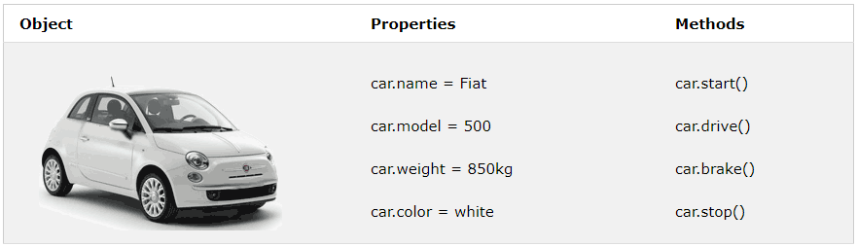
Object
An Object is a unique entity which contains property and methods.
In real life, a car is an object.
A car has properties like weight and color, and methods like start and stop:

Slide 4
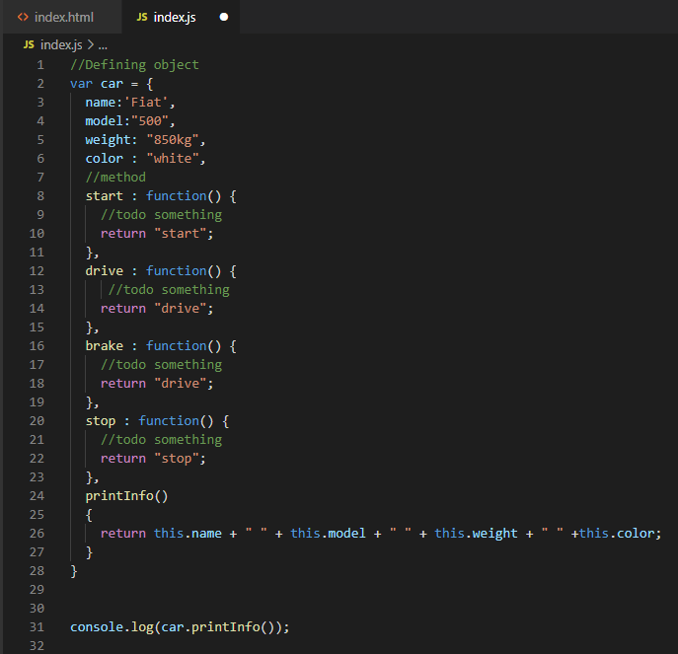
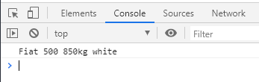

Slide 5
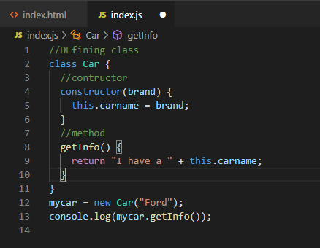
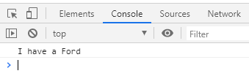
Classes
Classes are blueprint of an Object. A class can have many Object, because class is a template while Object are instances of the class or the concrete implementation.
Use the keyword class to create a class , and always add the constructor() method.

Slide 6
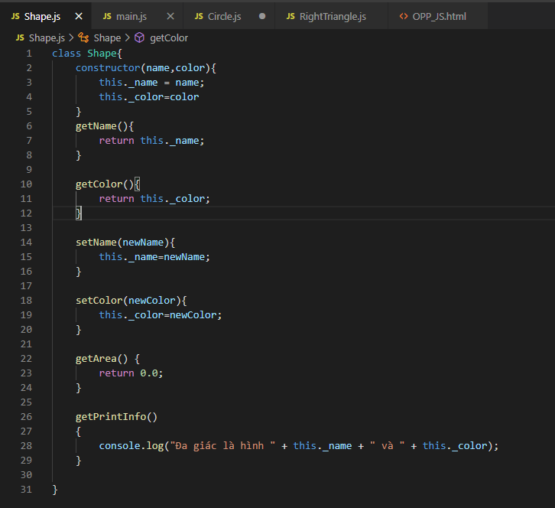
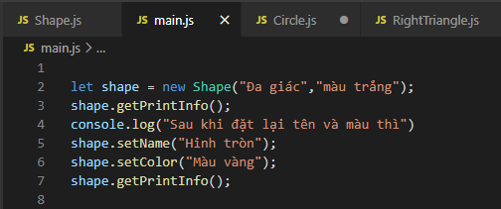
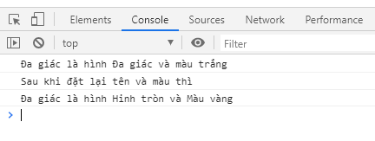
Encapsulation
Encapsulation is the process of bundling data and operations on the data together in an entity.

Slide 7
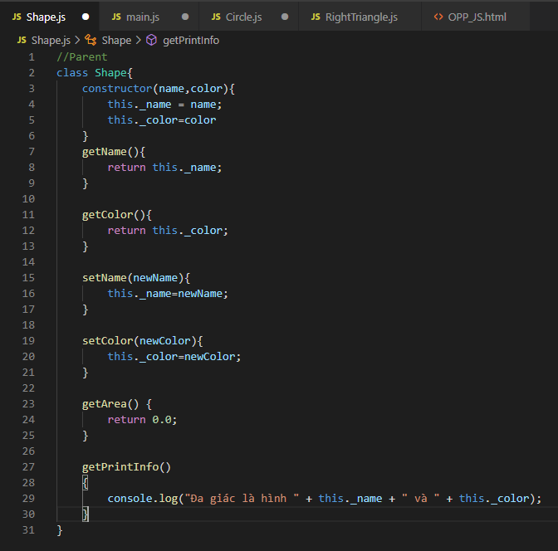
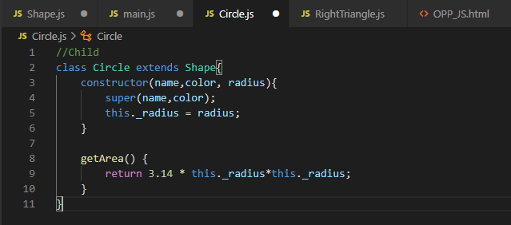
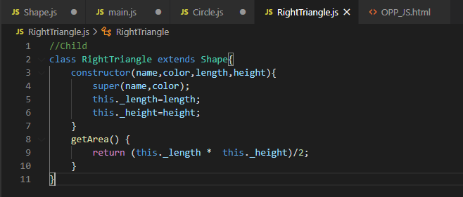
Inheritance
Inheritance is used to derive a new type from an existing type, thereby establishing a parent-child relationship.

Slide 8
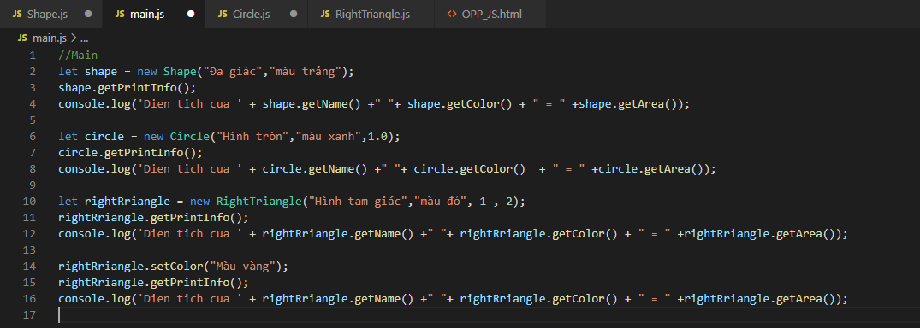
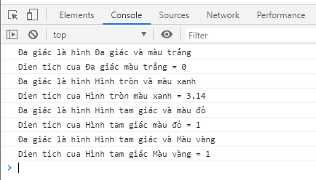
Inheritance

Slide 9
ES6
Scoping
Arrow Functions
Extended Parameter Handling
Template Literals
Extended Literals
Regular Expression
Object Properties
Destructuring Assignment
Modules
Classes
Symbol Type
Iterators
Generators
Map/Set & WeakMap/WeakSet
Typed Arrays
New Built In Methods
Promises
Meta-programming
Internationalization & Localization

Slide 10
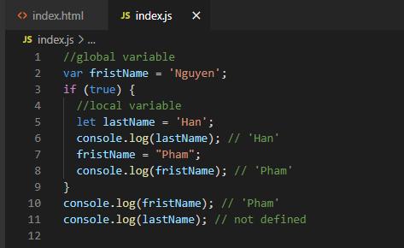
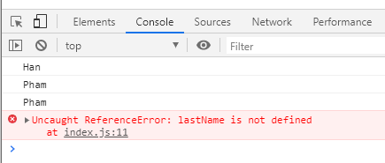
Scoping _Block-Scoped Variables
Block-scoped variables (and constants) without hoisting.

Slide 11
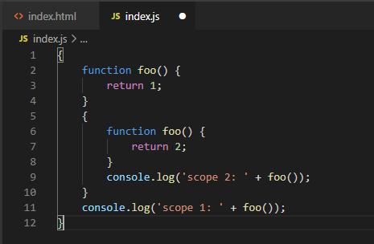
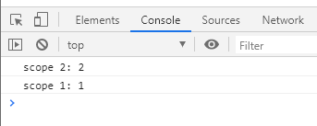
Scoping _Block-Scoped Funtions
Block-scoped function definitions.

Slide 12
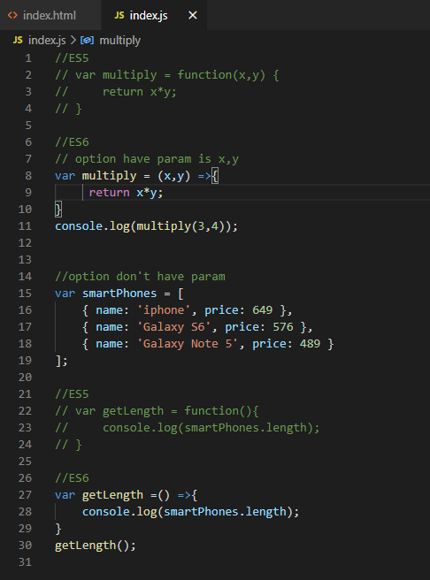
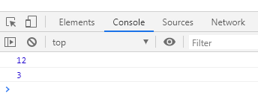
Arrow Functions

Slide 13
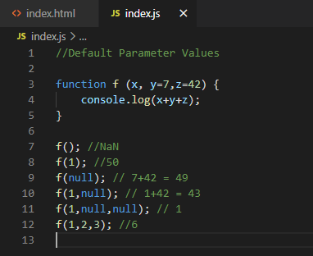
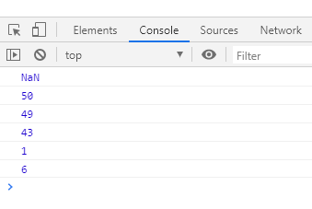
Extended Parameter Handling_Default Parameter Values

Slide 14
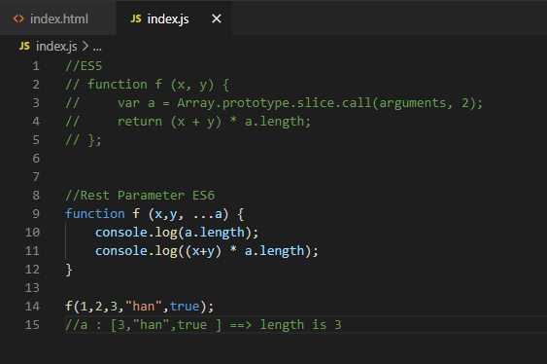
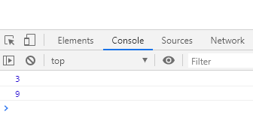
Extended Parameter Handling_Rest Parameter

Slide 15
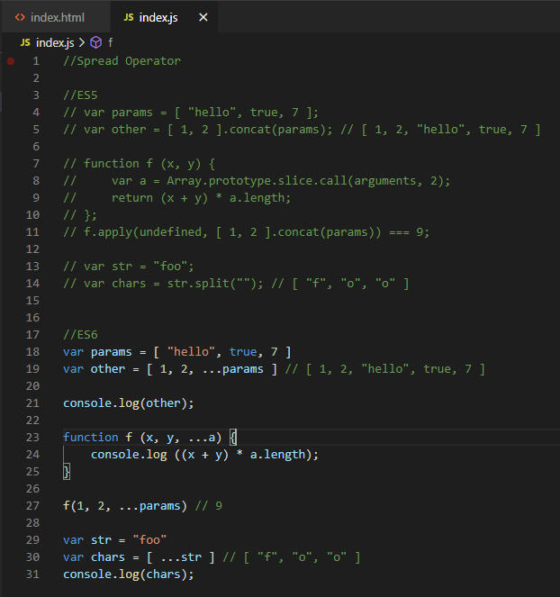
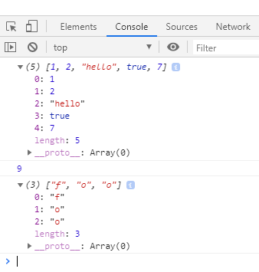
Extended Parameter Handling_Spread Operator

Slide 16
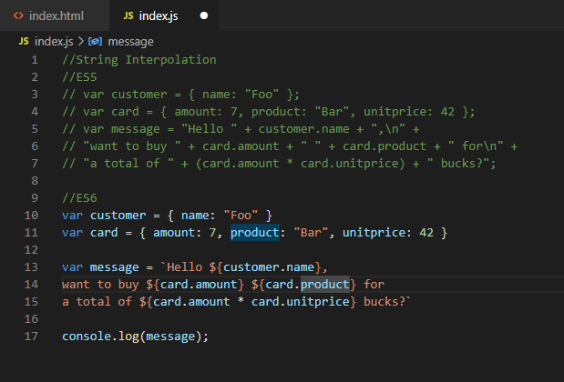
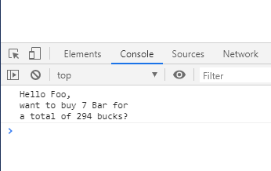
Template Literals_String Interpolation

Slide 17
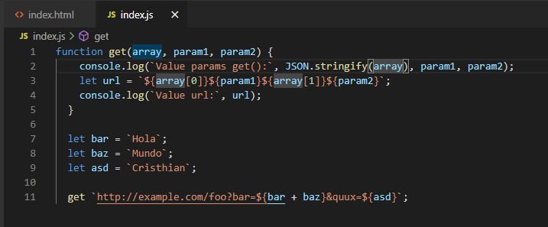
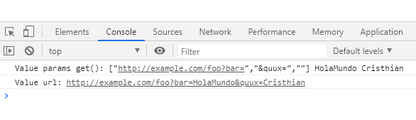
Template Literals_Custom Interpolation

Slide 18
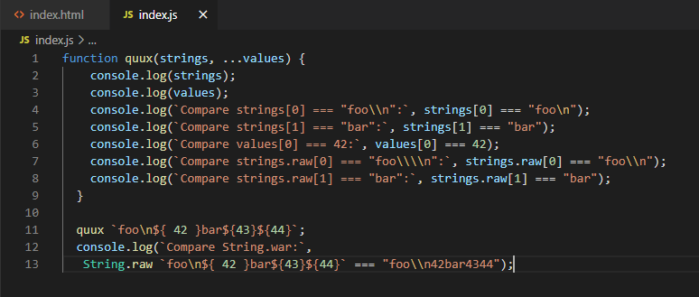
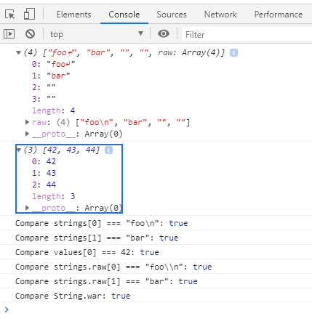
Template Literals_Raw String Access

Slide 19
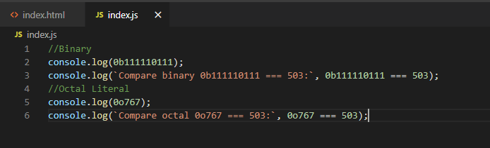
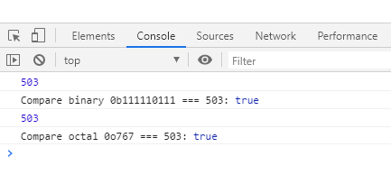
Extended Lirerals_Binary & Octal Literal

Slide 20
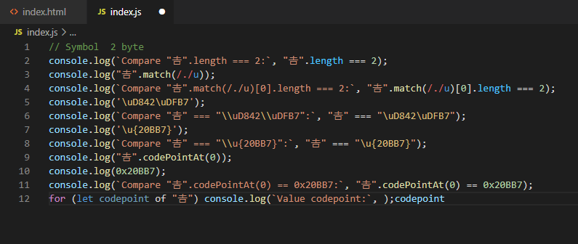
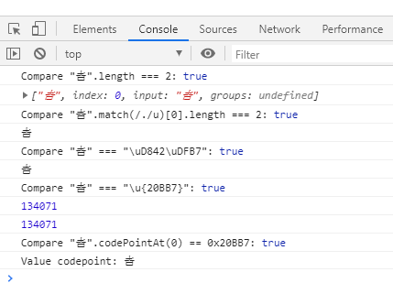
Extended Lirerals_Unicode String & RegExp Literal

Slide 21
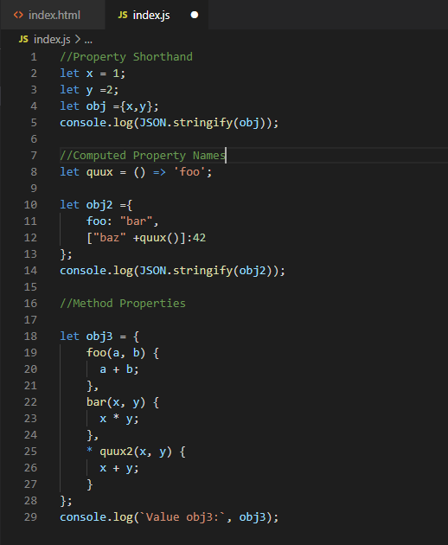
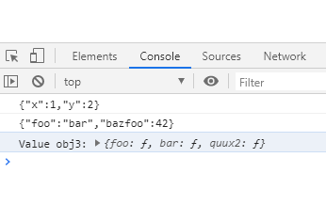
Enhanced Object Properties

Slide 22
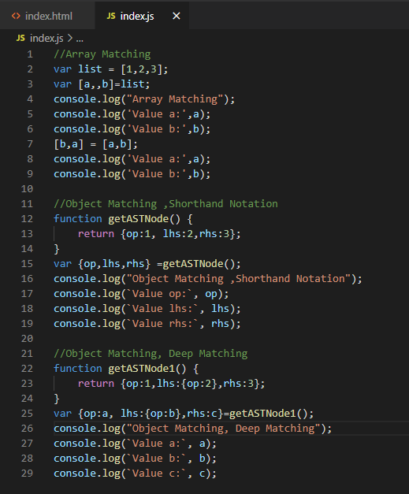
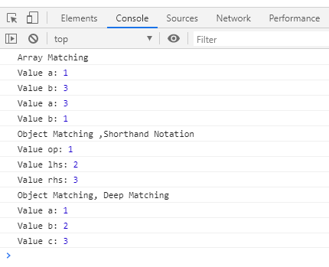
Destructuring Assignment

Slide 23
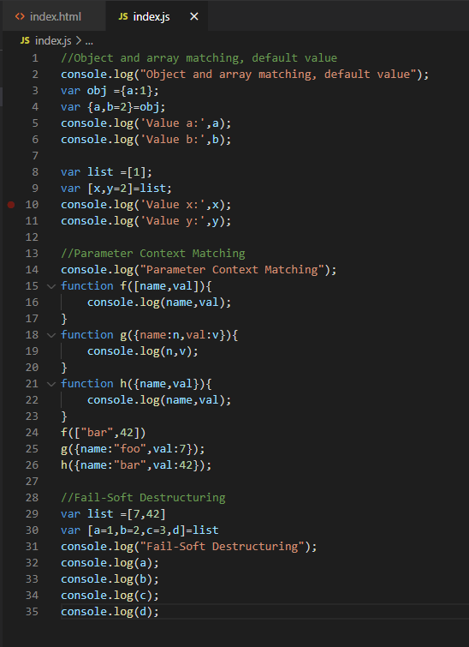
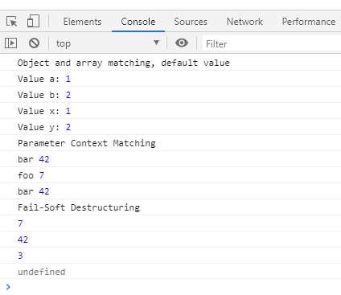
Destructuring Assignment

Slide 24
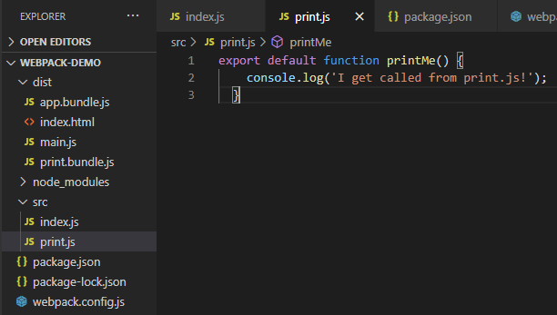
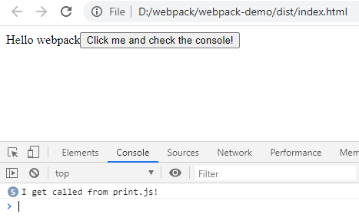
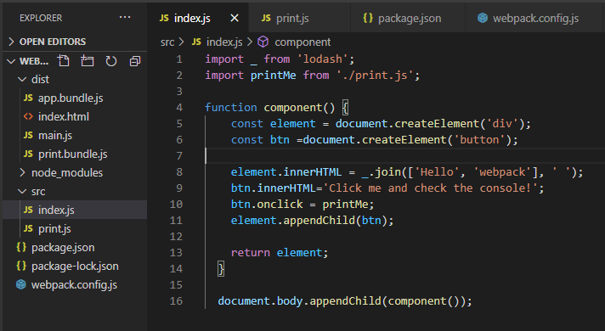
Modules (Using Webpack)

Slide 25
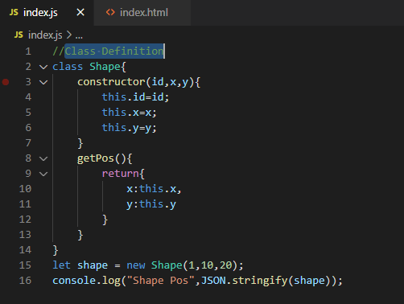
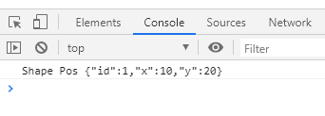
Classes_Class Definition

Slide 26
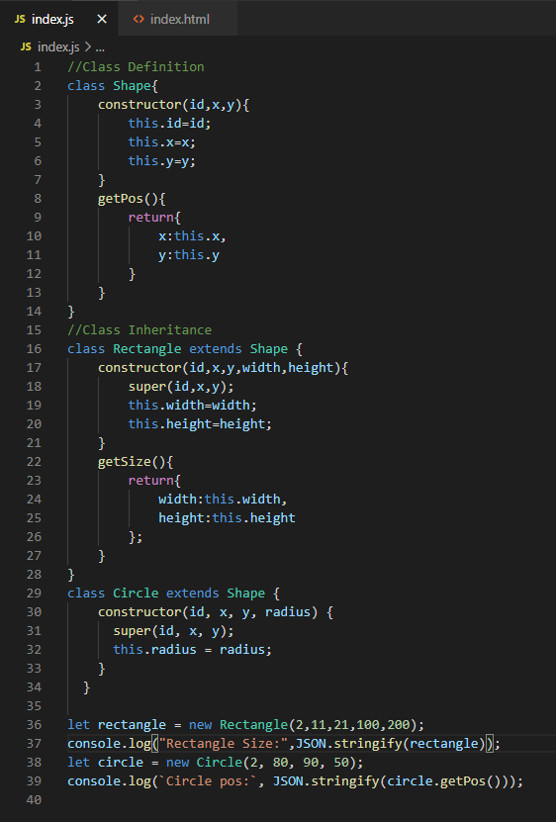
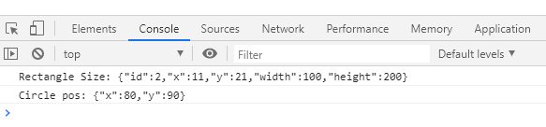
Classes_Class Inheritance

Slide 27
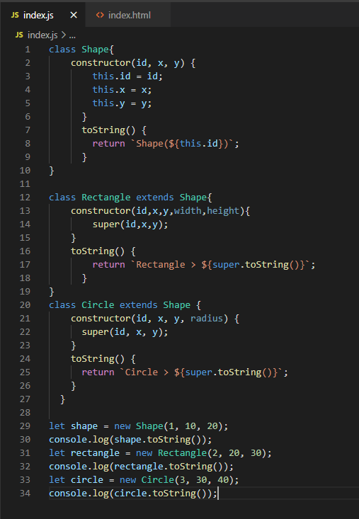
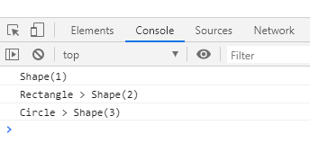
Classes_Base Class Access

Slide 28


Classes_Static Members

Slide 29


Classes_Getter/Setter

Slide 30


Symbol Type_Symbol Type
Unique and immutable data type to be used as an identifier for object properties. Symbol can have an optional description, but for debugging purposes only.
Notes:
Symbol là một kiểu dữ liệu được sinh ra nhằm tao ra các giá trị duy nhất, mỗi một symbol được tạo ra sẽ có một giá trị khác nhau và giá trị đó là duy nhất.

Slide 31


Symbol Type_Global symbol
Global symbols, indexed through unique keys.

Slide 32


Interator_Iterator & For-Of Operator

Slide 33


Generators

Slide 34
Generators

Slide 35


Generators

Slide 36


Generators

Slide 37


Map/Set & WeakMap/WeakSet

Slide 38
Map/Set & WeakMap/WeakSet

Slide 39


Type Array

Slide 40


New Built-In Methods

Slide 41


New Built-In Methods

Slide 42


New Built-In Methods

Slide 43


Promises

Slide 44


Meta Programming

Slide 45


Internationalization & Localization Collation

Slide 46
Webpack
Install Webpack
Webpack Bundle
Using a Configuration
Loading CSS
Loading Image
Loading Fonts
Loading Data
Html WebpackPlugin
Cleaning up the /dish folder
Using Source maps
Watch Mode
Webpack-dev-server
Webpack-dev-middleware
Minify CSS
Minify JavaScript
Loading SCSS
Caches

Slide 47



Install Webpack
npm int –y
npm install webpack webpack-cli –save-dev

Slide 48



Webpack Bundle
npm install --save lodash

Slide 49


Webpack Bundle
npx webpack

Slide 50


Using a Configuration
npx webpack –config webpack.config.js
npm run build

Slide 51




npm install --save-dev file-loader
Loading CSS

Slide 52



Loading CSS
npm run build

Slide 53



Loading Image
npm install –save-dev file-loader

Slide 54


Loading Image
npm run build

Slide 55



Loading Font
npm install –save-dev file-loader

Slide 56



Loading font
npm run build

Slide 57



Loading Data
npm install --save-dev csv-loader xml-loader

Slide 58


Loading font
npm run build

Slide 59




Html WebpackPlugin
npm install --save-dev csv-loader xml-loader

Slide 60


Html WebpackPlugin
npm run build
It will replace our index.html file with a newly generated one .
The HtmlWebpackPlugin has created an entirely new file and that all the bundles are automatically added.
Before
After

Slide 61


Cleaning up the /dish folder
npm install --save-dev clean-webpack-plugin
In general it's good practice to clean the /dist folder before each build, so that only used files will be generated.
Suppose I create draf.js in dist folder

Slide 62

Cleaning up the /dish folder
npm run build

Slide 63


Source map
In order to make it easier to track down errors and warnings, JavaScript offers source maps, which map your compiled code back to your original source code. If an error originates from b.js, the source map will tell you exactly that.

Slide 64


Source map
npm run build

Slide 65


Watch Mode
If one of these files is updated, the code will be recompiled so you don't have to run the full build manually.

Slide 66



Watch Mode
npm run watch
Change file index.js and reload page index.html

Slide 67


Webpack-dev-server
The webpack-dev-server provides you with a simple web server and the ability to use live reloading.
npm install --save-dev webpack-dev-server
Then npm start
This tells webpack-dev-server to serve the files from the dist directory on localhost:900

Slide 68



Webpack-dev-server
Change file index.js we will see our browser automatically loading up our page.

Slide 69

Webpack-dev-middleware
Webpack-dev-middleware is a wrapper that will emit files processed by webpack to a server. This is used in webpack-dev-server internally, however it's available as a separate package to allow more custom setups if desired.
npm install --save-dev express webpack-dev-middleware
Create server.js

Slide 70


Webpack-dev-middleware

Slide 71

Webpack-dev-middleware
Now in your terminal run npm run server . Now fire up your browser and go to http://localhost:3000.

Slide 72
Minify CSS

Slide 73
Minify JavaScript

Slide 74
Loading SCSS

Slide 75
Caches

